Slide 1
HOTEL STARK
NAMBURU CHANDANA(2103A51481)
SAMUDRALA DEEPIKA(2103A51427)
K.CHAITANYA JYOTHI(2103A51280)
THOUTAM SHRAVANI(2103A51295)
BATHINI VANDANA(2103A51348)

Slide 2
ABSTRACT
This project is to create website by following the principles of Human Computer Interaction which guides travelers by providing them with information about hotels in Warangal.
This Project aims at creating an Hotel Reservation that can be used by customers to reserve hotel rooms. Users can view rooms and amenities. Users can register and log into the system. The administrator will know the details of daily reservation done by users. Purpose of making such application is to make people’s work quicker and save time of users.

Slide 3
ABOUT WEBPAGES
Number of webpages present in our website - 9 using HTML code,CSS & Javascript concepts.
Color combinations – menu bar –white with black menus text in it,photo(mostly blue) in the background.
Hotel Reservation page – violet background with text in black colour left aligned.
Font style – Lucida Console
Size: 12px

Slide 4
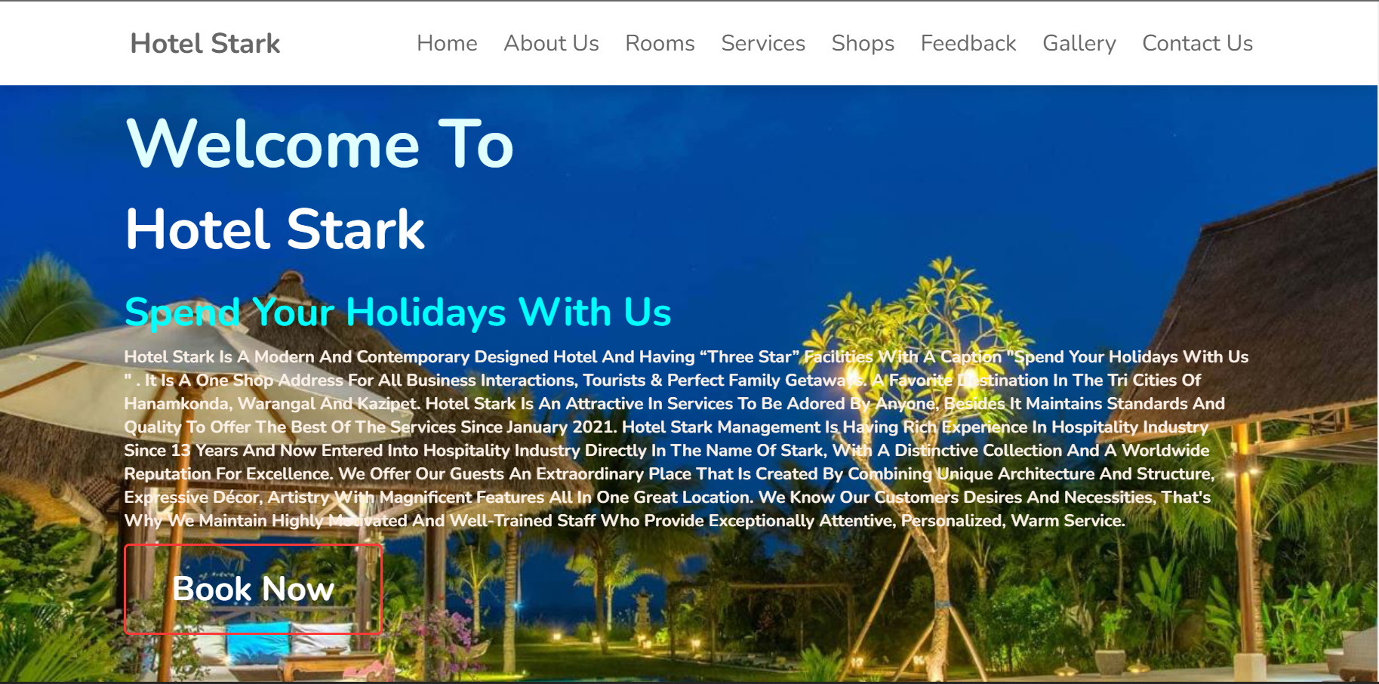
HOME
WP1: Home
It gives a brief outlook of the website and has “Book Now” button and by clicking on it, it navigates users to another webpage where we have to enter details.
The menus “About Us ", “Rooms ", “Services", “Shop", “Feedback", “Gallery“ and “Contact" are stored data regarding some static pages about hotel information.

Slide 5
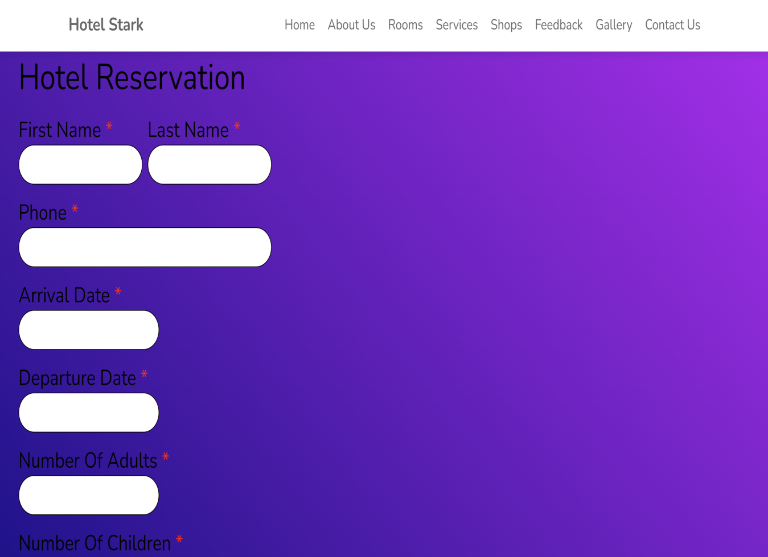
BOOK NOW
If users would like to book a room in Hotel Stark, they can click this button for a start. When they click it, the page will be linked to User Login page to let users enter details of the user in order to login.

Slide 6
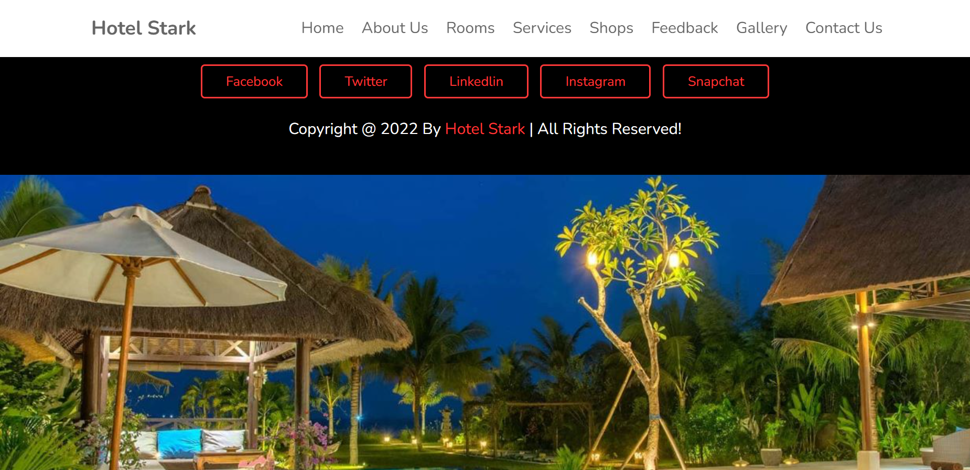
ABOUT US
WP2: About us
It describes all aspects of our hotel and gives detailed information about our hotel.
By this page the user can understand our hotel by reading the content
This page gives the exact information about the hotel

Slide 7
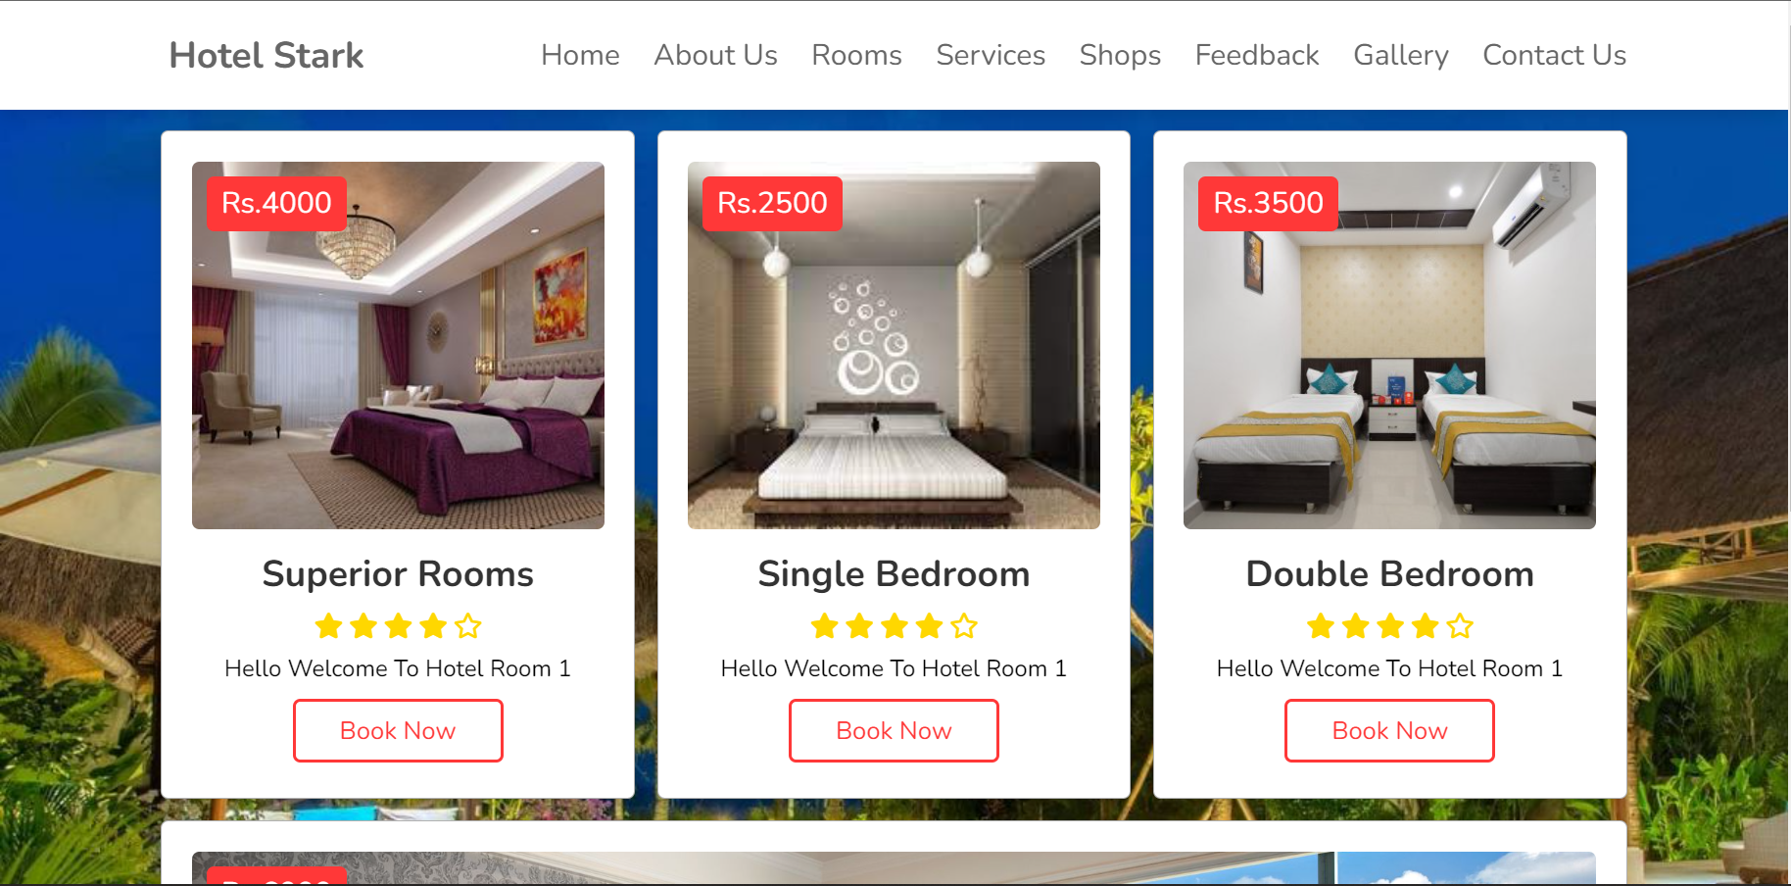
ROOMS
WP3: Rooms
This webpage is about the availability of rooms categorized as per the user’s requirements.
When we click on the room option and select a room, it navigates us to another webpage where we can book a room.

Slide 8
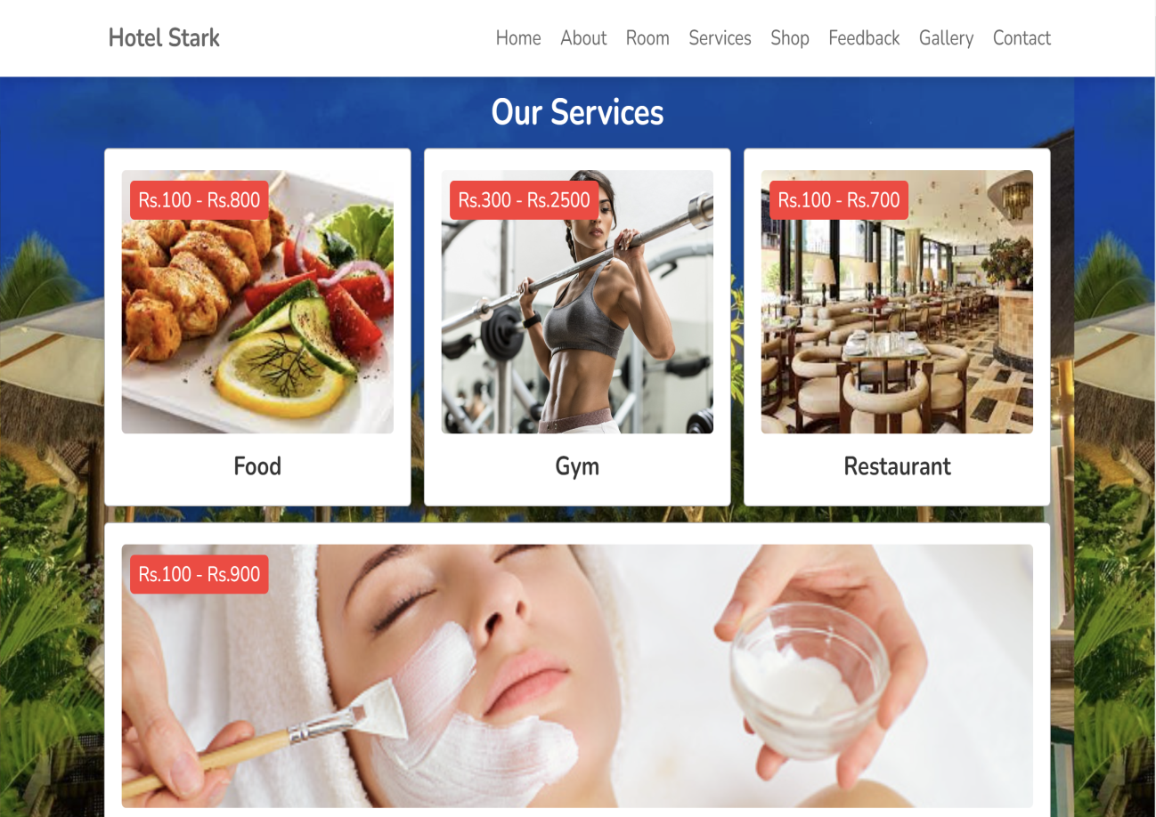
SERVICES
WP4: Services
This webpage is about the services provided by our hotel such as food(you can order your food by staying at your room),inbuilt restaurant, gym, spa etc.

Slide 9
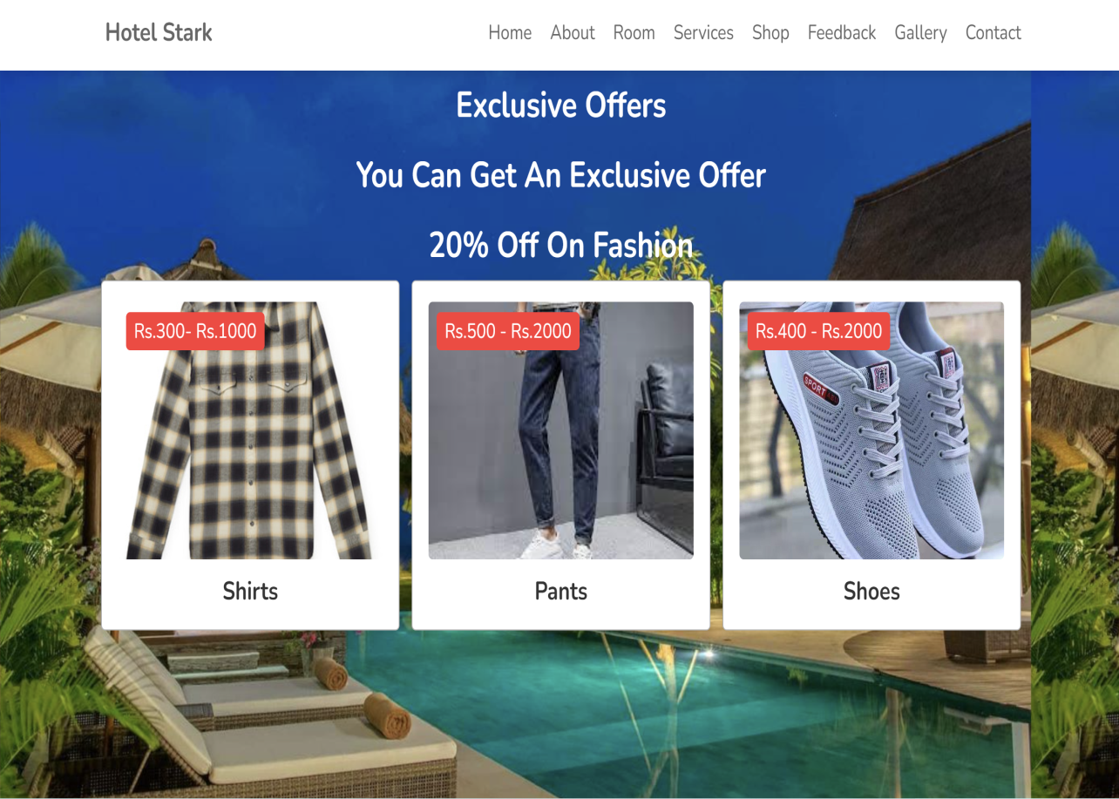
SHOP
WP5: Shop
This webpage is about the products users can buy when they visit our hotel
This webpage is about the shops which are in our hotel where the visitors can buy products

Slide 10
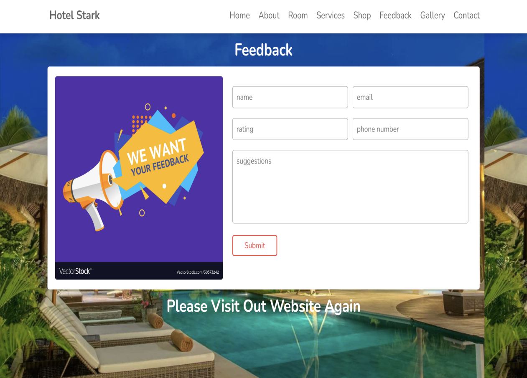
FEEDBACK
WP6: Feedback
In this webpage, we ask for the user’s feedback in order to refine our website.
If user have any suggestion or complains in the improvisation of our website, they can use the suggestion box to post them

Slide 11
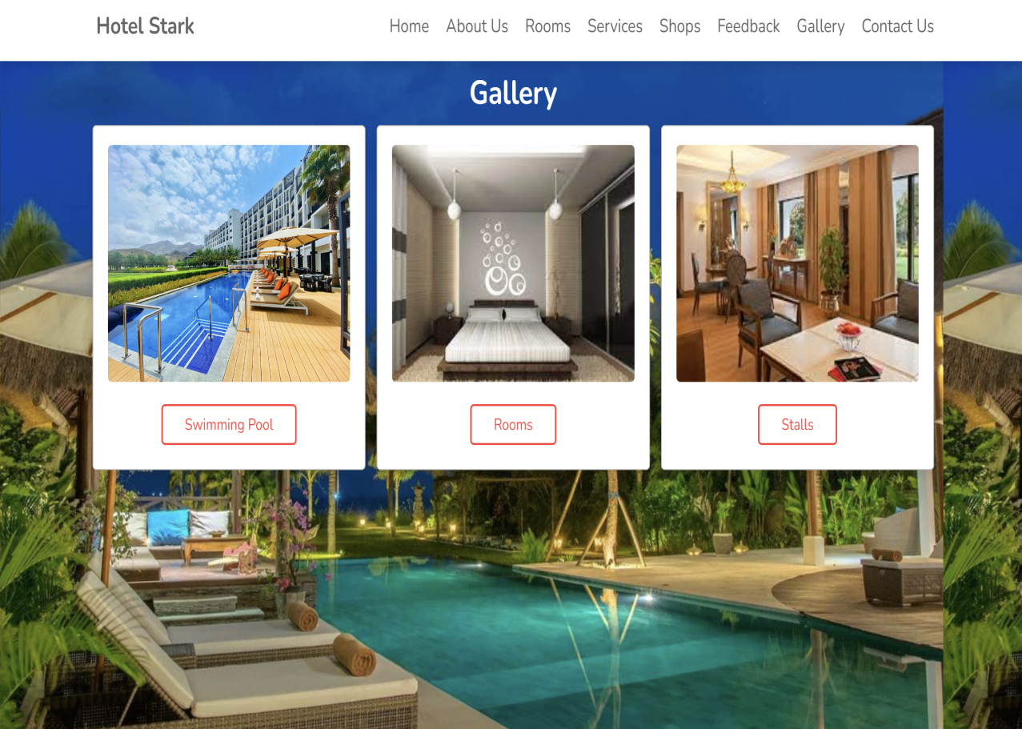
GALLERY
This webpage includes photos of our hotel.
It is a page where the visitors post the images of the hotel
In this webpage there are pictures of our hotel which is helpful users when they want to book a room.

Slide 12
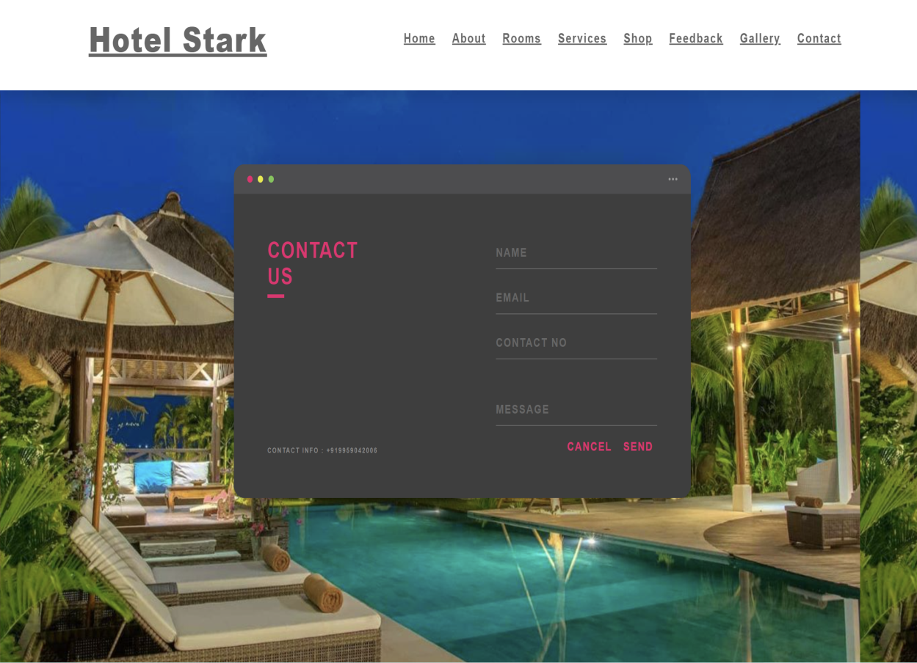
CONTACT US
This webpage is for users to contact us for any queries.
This helps the users to clear issues or problems faced by them

Slide 13
CONCLUSION
This website enables user to book hotel rooms in Warangal when they visit our webpage.
Hotel Stark provides an environment for users to book hotel rooms, perform booking activities, and manage personal account at Hotel Stark with the help of a web browser.
To implement the system, we used JavaScript, HTML, and CSS. Hotel Stark is a user-friendly and easy-to-use website.

Slide 14
FUTURE SCOPE
In future we are planning to extend our website into an application where every hotels are being included.
We are also planning to add an option called hosting any kind of event by customer called as Event Organizing.
Furthermore making it more efficient and user friendly interface.
Some extra features like cab booking , flight ticket booking,etc services will be added

Slide 15
REFERENCES
[1]Shelly Cashman Woods. "HTML Complete Concepts and Techniques", Second Edition, Thomson Course Technology, 2002. ,
[2] Jennifer Niederst. "Learning Web Design", First Edition, O'Reilly & Associates, Inc., 2001

